Slide 1
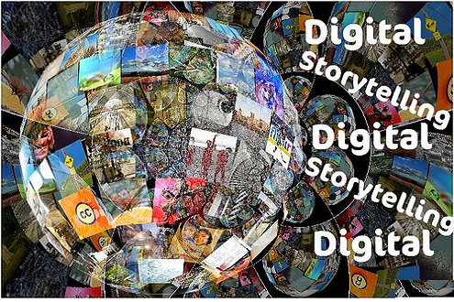
What is a Digital Story?
Ms. Janacek
8th Grade L.A.

Slide 2
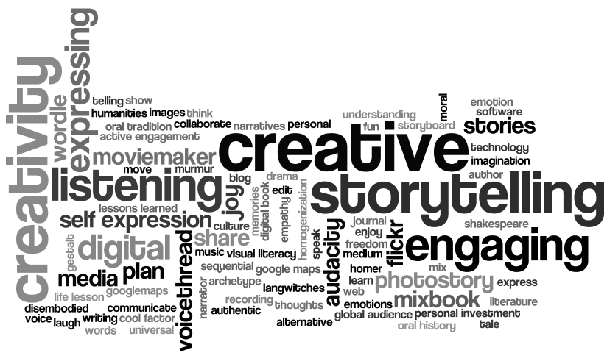
Digital Story
digital media production that allows everyday people to share aspects of their life story.
individuals can use to tell a story or present an idea using technology.

Slide 3
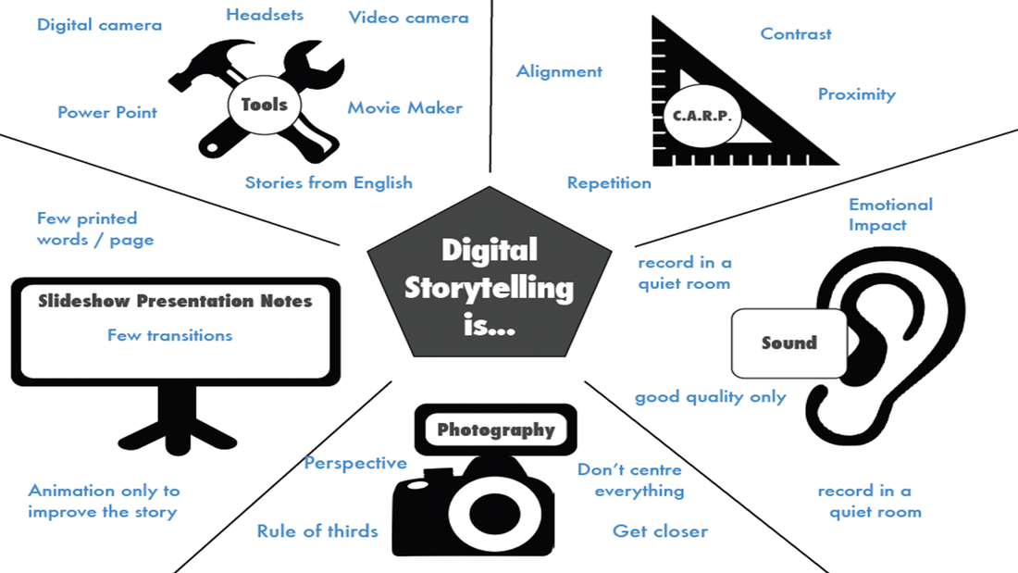

Slide 4
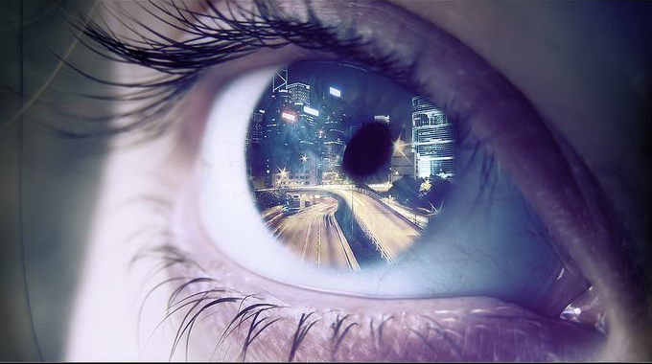
10 Elements of a Digital Story
1. Point of View - What is your purpose? What is the goal?
2. Narrator's Point of View
3. A Dramatic Question - the action, tension, central desire…
4. Content/paradigm/theme - inspirational, love, loneliness, friendship…
5. Gift of your voice - your audio recording (practice and relax, be conversational)

Slide 5
Tone/Mood
What’s the difference between these two versions?

Slide 6
10 Elements of a Digital Story
6. Pacing of your narrative
7. Power of your audio - music, sound effects, your own lyrical narration (watch copyright)
8. Images - the quality and type of media (video, animations, photos, graphics...)
9. Economy of the story detail - the sequence of events, images, text - (keep it simple)
10. Appropriate grammar and language usage

Slide 7
Digital Storytelling Process Involves...
Preparing to tell your story.
What is it going to be about?
What type of story are you telling?
What is your own connection to the story?

Slide 8
Examples: Feast

